Slide 1
PMI NC CHAPTERS COLLABORATION MEETING
3 CHAPTERS
NCPMI
TRIAD
METROLINA
Presents: "Meet Like You Mean it" with Wayne Turmel

Slide 2


21-May-19
Please Mute Your Mic!
Chat with us instead!
Notes:
Anna

Slide 3
Charlotte Community agenda
PMI Coronavirus Update - Chapter Presidents
Chapter Overviews & Introductions
NC-PMI Chapter - Robert "Bobby" Robinson
Triad Chapter – Annette Hayes
Metrolina Chapter – Rhonda Evans
"Meet Like You Mean It" - Wayne Turmel (1.25)
- Q & A Session - 15 mins
Chapter Survey's & Upcoming Meetings (5 mins each)
NCPMI Chapter
Triad Chapter
Metrolina Chapter
Collaboration Meeting Poll
-
Notes:
Anna

Slide 4
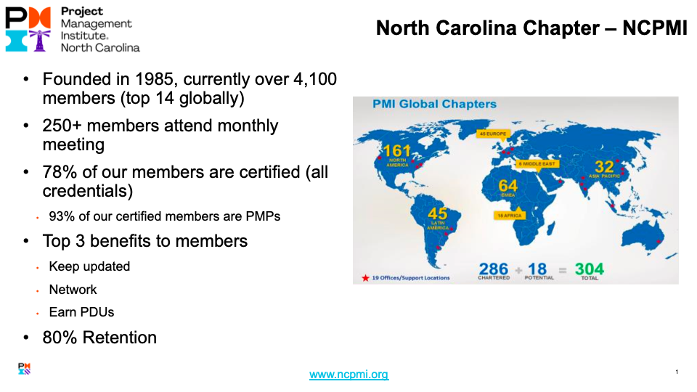

Slide 5
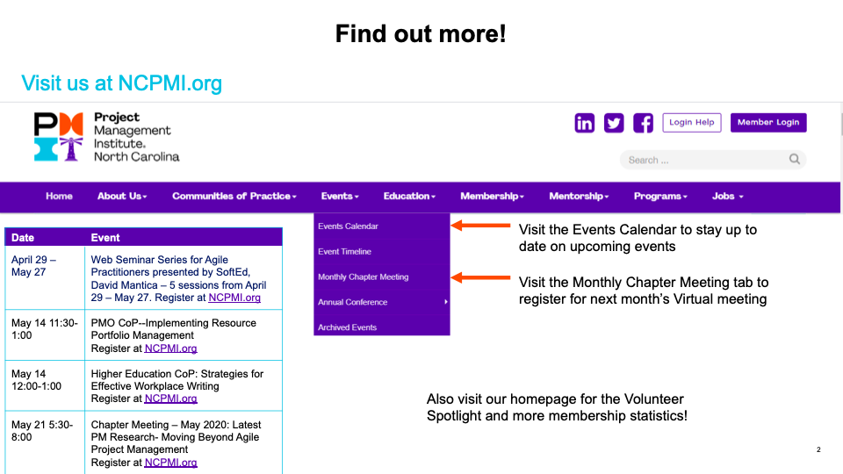

Slide 6
Triad Chapter
V.P. OF PROGRAMS
ANNETTE HAYES

Slide 7

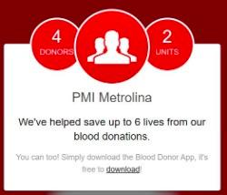




Help save lives with a blood donation and get a free PMI Metrolina t-shirt.
Join the PMI Metrolina American Red Cross team at this link: PMI Metrolina Red Cross Team
PMI Metrolina, founded 1985
FROM THE MOUNTAINS TO THE BEACHES OF NORTH CAROLINA​
As of 3/31/2020
Credential​ | Credential Count​
PMP​ | 1966​
PMI-ACP​ | 76​
CAPM​ | 48​
PMI-RMP​ | 13​
PgMP​ | 12​
PMI-PBA​ | 12​
PMI-SP​ | 3​
PfMP​ | 2​
Total​ | 2,132​
11 COMMUNITIES ​
Asheville
Ballantyne
Cabarrus
Charlotte
Fayetteville
Huntersville
Jacksonville
Mooresville
University
West Lake Norman
Wilmington
2, 856 members ​
98 volunteers

Slide 8
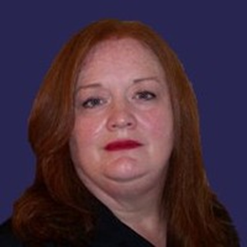
Volunteer of the Month - APRIL
DEBRA DONALDSON
Debra’s love for Project management shows in how she takes the initiative to find the right speaker for the community. She is always ahead of the game and requires little to no support. Debra is a good volunteer that loves what she does. With this mindset, it adds tremendous value to the PMI-Metrolina Chapter. We started our PMI monthly meetings via the web in March. Debra was able to take charge and run fearlessly with the meeting with no hesitation.
Debra Donaldson has been a PMI member since October, 1999. Debra started her PMI membership with the Birmingham chapter in October 1999 through June 2005. She held the position in Birmingham as Special project chair. She joined the PMI-Metrolina chapter in July 2005 and now holds the position of Co-chair for PMI Metrolina Cabarrus County Community.
Notes:
Tish

Slide 9
Our Featured Speaker

Slide 10
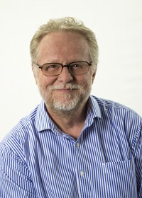
Collaboration Webinar – April 21 5:30-7:30
PRESENTER: WAYNE TURMEL
TOPIC: ”MEET LIKE YOU MEAN IT”
Wayne Turmel is a writer, speaker, and the co-founder of the Remote Leadership Institute. For over 20’s he’s been obsessed with helping people communicate and keep their sanity in a remote and dispersed workplace.
Meeting Outcomes: Discover how to plan virtual meetings to give yourself a chance at success and best practices of great virtual meeting leaders!

Slide 11
Virtual Project Meetings
They don’t have to suck. Really

Slide 13
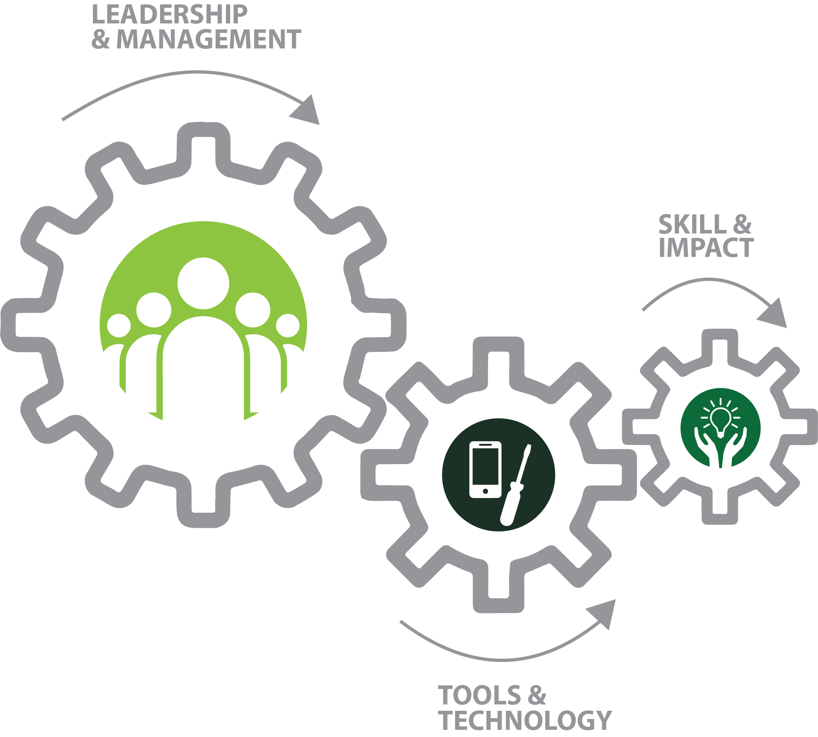
Remote Leadership

Slide 14
How Productive Are
Your Virtual Meetings?
Very productive
Pretty good, but we could improve
Not as productive as we’d like
They aren’t very productive at all

Slide 15
Top Complaints
About Virtual Meetings
Technology doesn’t work like it should
Too long
Not focused
Don’t accomplish their goals
No interaction

Slide 16
Complaints About
“Regular” Meetings
Lack of focus
Poor facilitation
Getting off track
Wasted time

Slide 17
Two Elements of a Great Meeting
Plan with success in mind
Facilitate and lead to your desired outcome

Slide 18
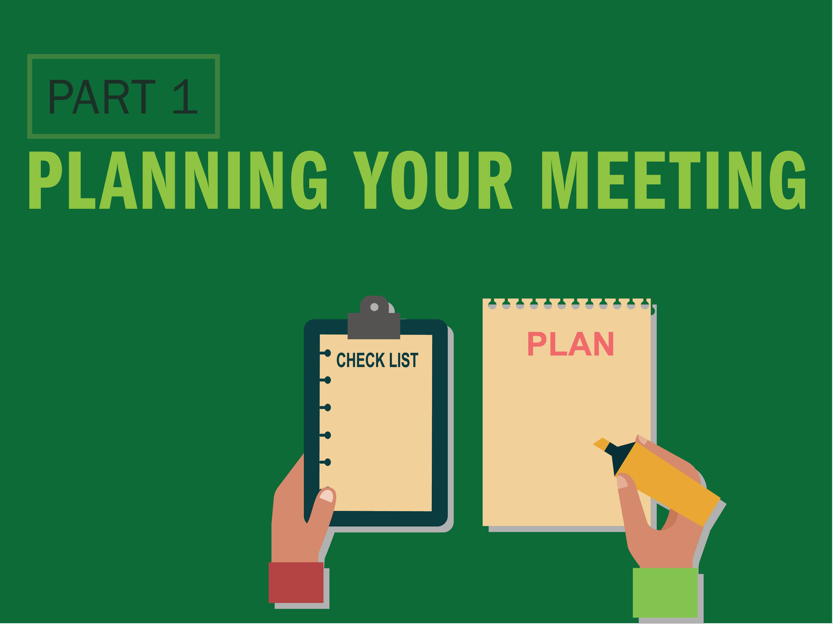

Slide 19
What’s Your Purpose?
Deliver information?
Brainstorm?
Make a decision?
Reach consensus?
Build team communication?

Slide 20

What Tools Are You Using?

Slide 21
Tools to Take Advantage Of
Open microphones
Webcams
Whiteboards
Chat
Polling
Breakout rooms

Slide 22

Do You Send an Agenda
For Every Meeting?

Slide 23
Elements of a Good Agenda
Logistics
  Date
  Time
  Length
  As much prep as you can give
Purpose of the meeting
Desired outcome(s)
Expectations
Any pre-work or assigned documents
(with how to find them)

Slide 24

Part 2: Leading Your Meeting

Slide 25
Ground Rules Matter
Purpose of the Meeting
Desired outcomes
How you’re trying to achieve it
  Participation
  Tools
How to interact
How you’ll manage time
Make sure they know—don’t guess

Slide 26
Encourage Interaction

Slide 27
Hybrid Meetings
Appoint a “speaker monitor”
Manage the noise
Start questions and comments with the remote attendees
Repeat and rephrase information for those not in the room
Sometimes it’s better for everyone to be online

Slide 28

Have a Questioning Strategy
“Anyone”
“Hey you”
“Anyone but you”

Slide 29
Wrap It Up
Give fair warning
Celebrate accomplishments
Document and distribute all action items
What’s next?
  Action items
  Reference material & handouts
Thank them one and all

Slide 31
Action Plan
What needs to be done?
By whom?
When?
How will you support this action with the team?
What help do you need,
from whom?

Slide 32


Win one FREE copy
wayne@remoteleadershipinstitute.com
Or LinkedIn to Wayne Turmel

Slide 33
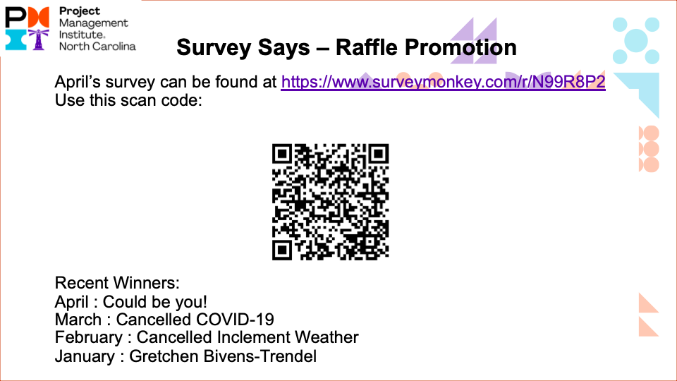

Slide 34


Slide 35
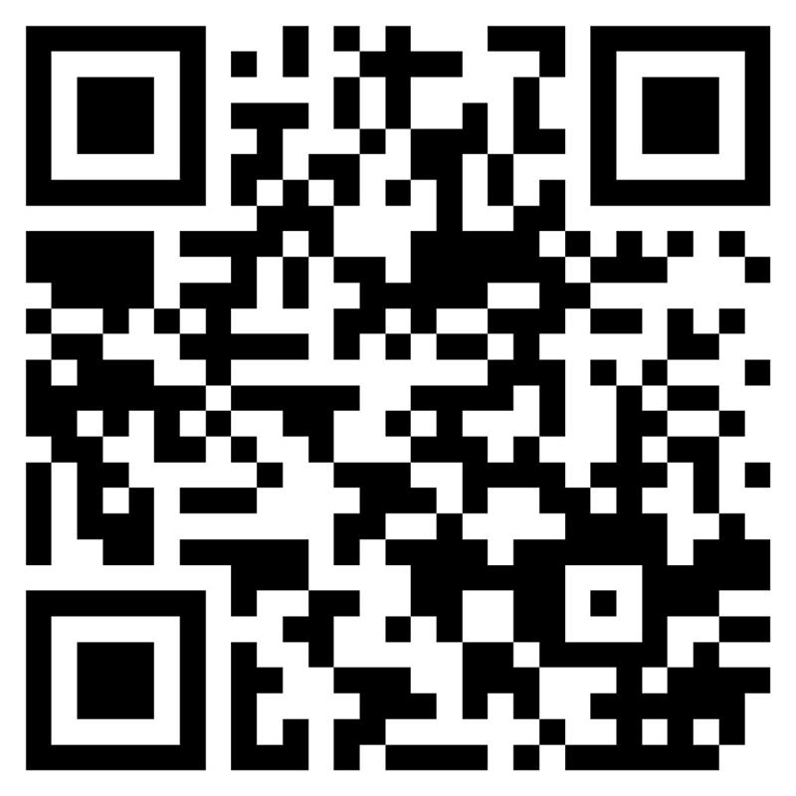
We would love to hear your thoughts about today's meeting! Scan the QR Code now or copy & paste the URL below link below:
https://www.surveymonkey.com/r/V79WK7H

Slide 36
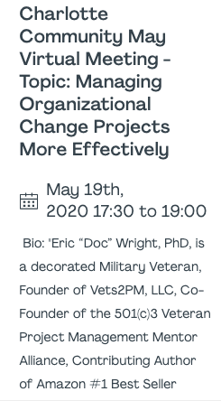
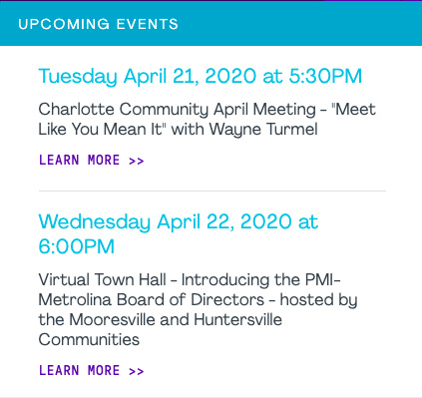

Slide 37




Visit us on our Social Media Sites!
 | PMIMetrolina
 | PMIMetrolina
 | PMIMetrolina
 | PMI-Metrolina
Notes:
RICH?

Slide 38
Collaboration Poll
Notes:
Anna Introduce, Rhonda conduct poll.

Slide 39


